Slide 1
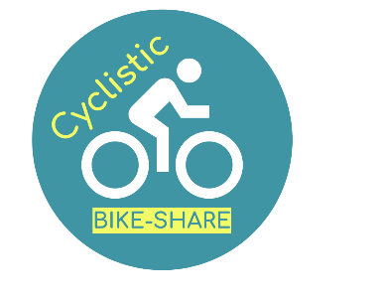
Influencing Casual riders for annual membership
Bike-share Company Analysis
Cinara Furmiga - August 2022

Slide 2
Objective
Increase numbers of annual membership

Slide 3
Analytical goals
WHY: Casual riders haven’t become members
HOW: How influence casual riders to become members

Slide 4
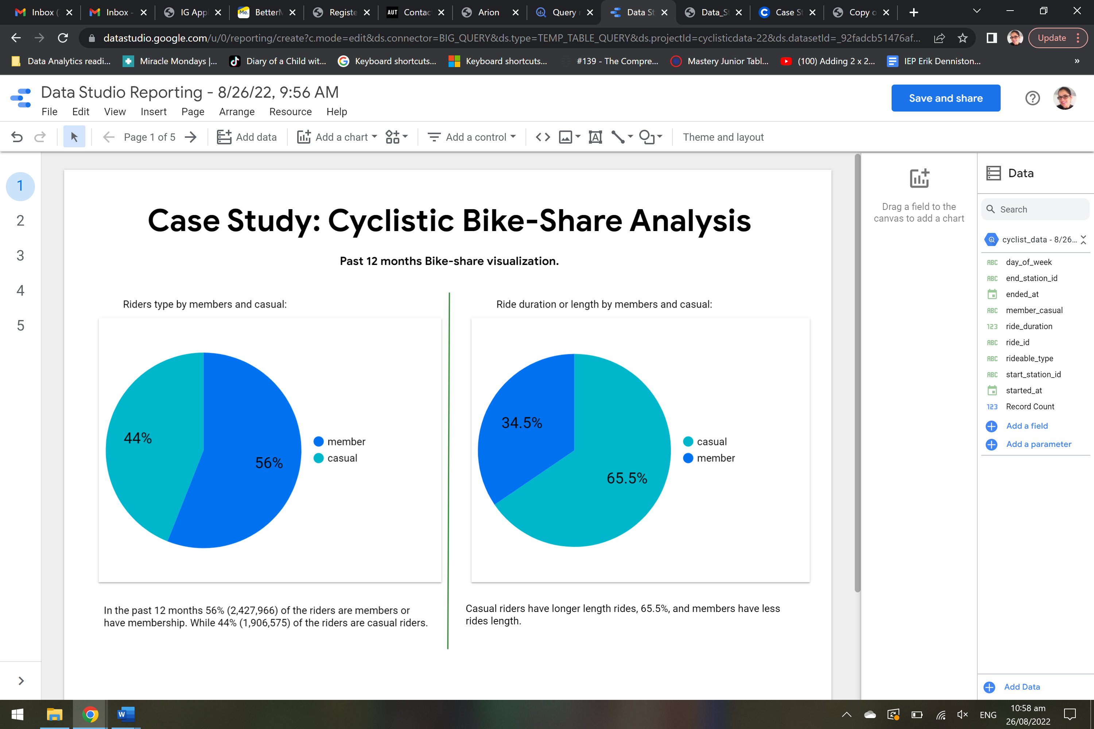
Analysis of past 12 months - June 21 to May 22. How casual riders are using bike-share
The past 12 months 44% were casual rides.
The length or duration of casual rides were 65.5%.

Slide 5
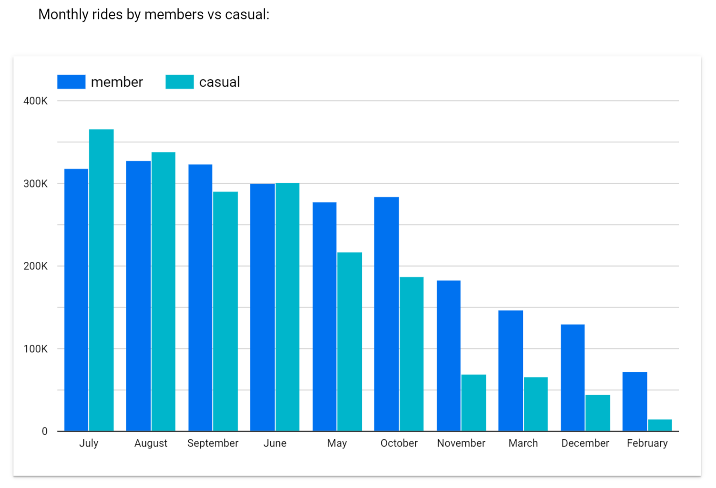
Observing casual customers rides usage per month:
High casual rides during summer period – peak in July.
Low casual rides during winter period – from December to April.

Slide 6
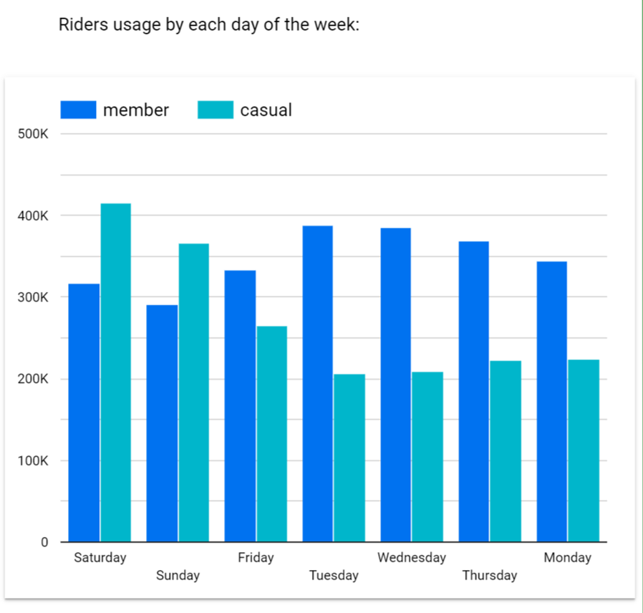
Observing casual rides usage by day of the week:
High casual rides activity on weekends.
members rides activity higher on weekdays.

Slide 7
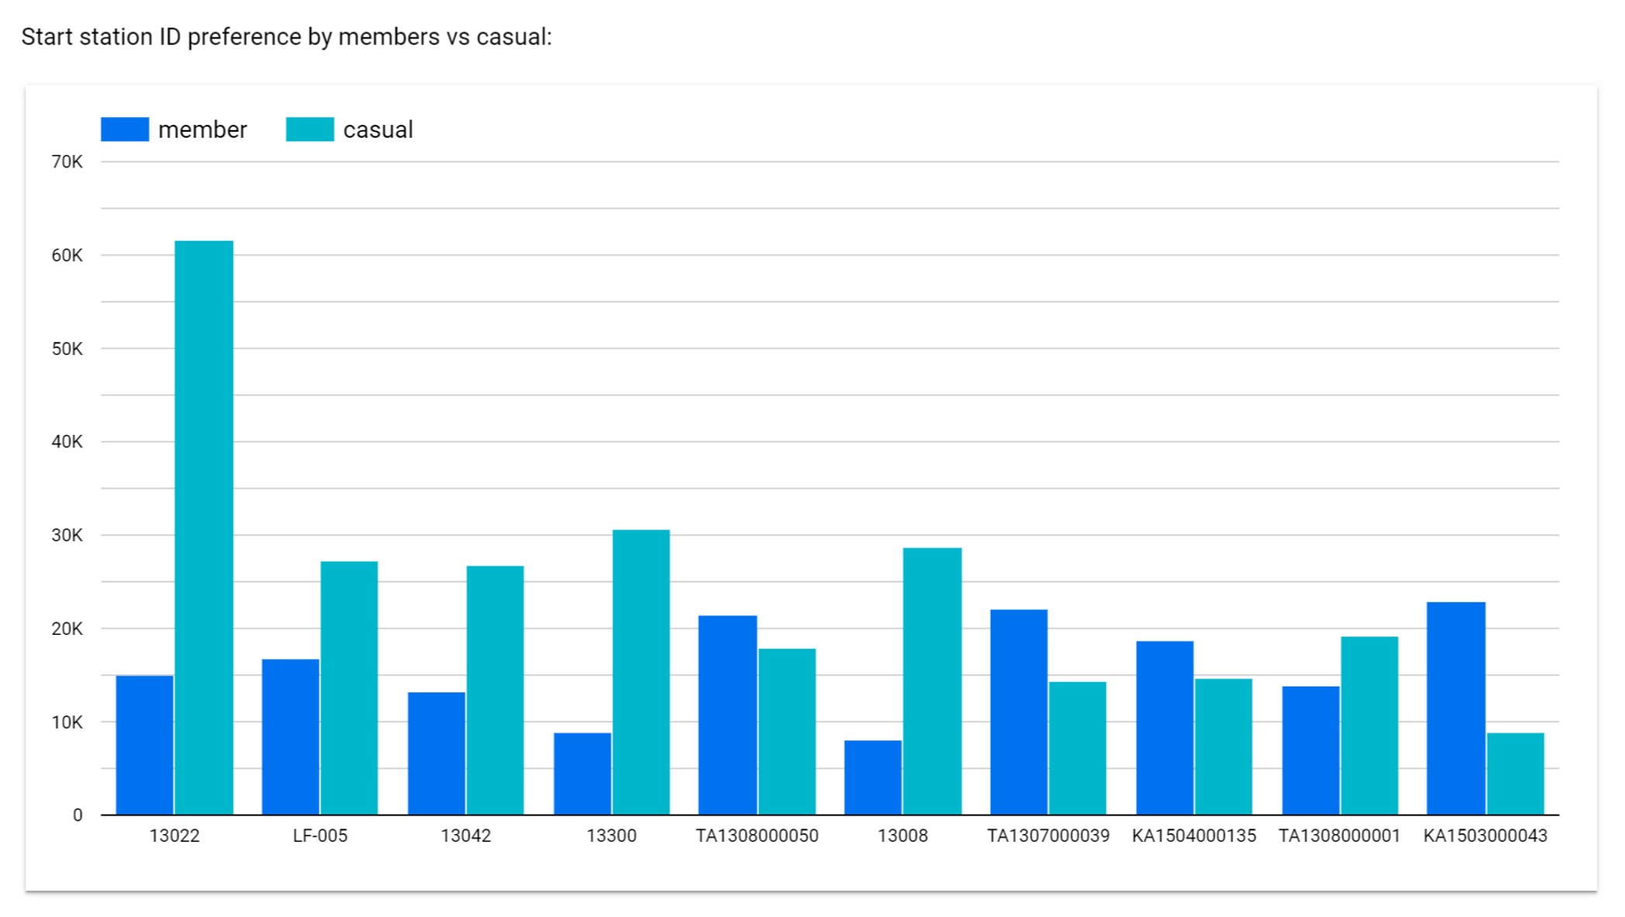
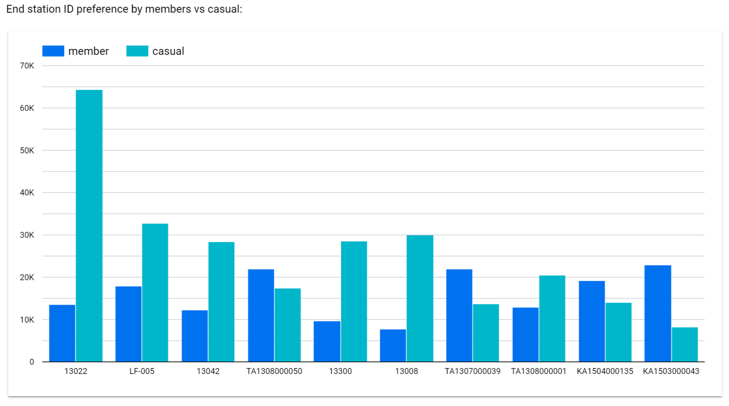
Start station preference by casual riders:
Start station ID 13022 followed by station ID 13300
End station preference by casual riders:
Start station ID 13022 followed by station ID LF-005

Slide 8
High activity of casual rides stations are tourist spots such as Lake shore views and Parks.

Slide 9
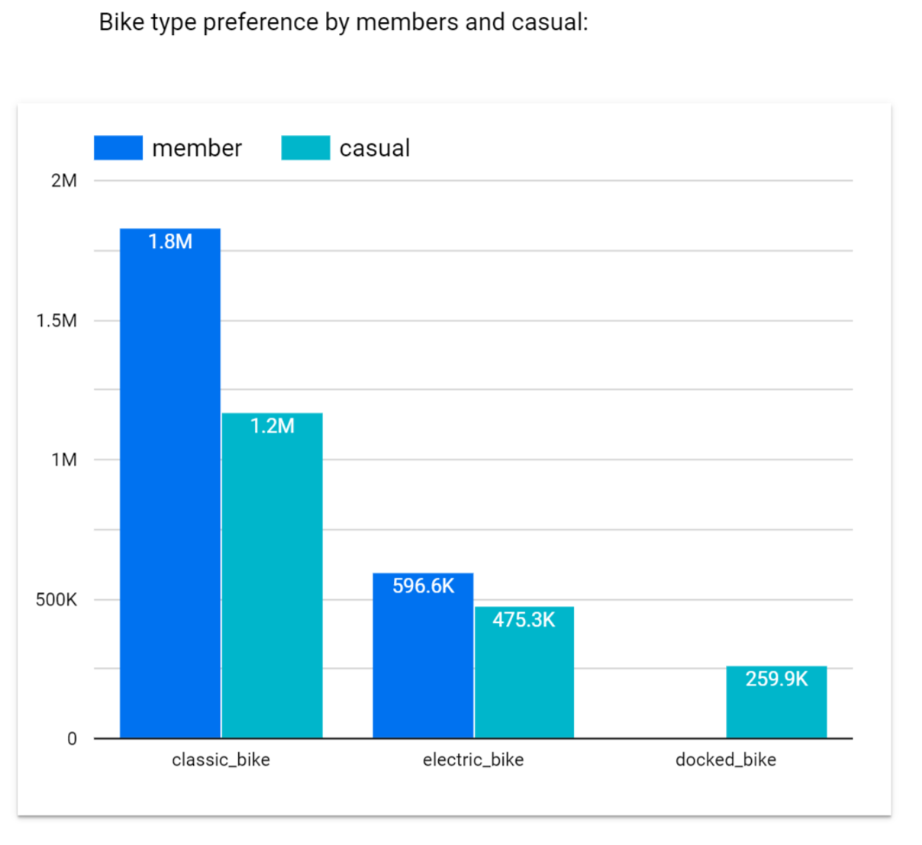
Casual riders bike preference are Classic bike followed by Electric bike.

Slide 10
Thus, casual rides are high on summer period, on the weekends. Which explains the high activity on tourist location.

Slide 11
In summary
WHY: Casual riders’ high activity at summer period on weekends at tourist locations
HOW: Increase awareness of the service by launching advertisement, presenting the benefits

Slide 12
The Strategy – campaign advertisement
Campaign launch summer period to bring awareness of the service and brand
The benefit of bike-share to work:
Economic, saving in petrol and parking
Avoid traffic
Health & Wellbeing
Physical advertisements on tourist locations and stations
Digital media: special offer by signing annual membership

Slide 13
Further Exploration
Have annual membership increased? By much?
Which advertise channel had best response?

Slide 14
Thank you

